Slide 1

Agentic AI Builder: Low-Code AI Agents & Voice Agents in n8n
Week 1
Day 1

Slide 2

AGENTIC AI BUILDER
The 3 week journey starts today
First let’s cover objectives, introduction, curriculum, logistics
Actually, let’s not.
I always start with INSTANT GRATIFICATION!!

Slide 3
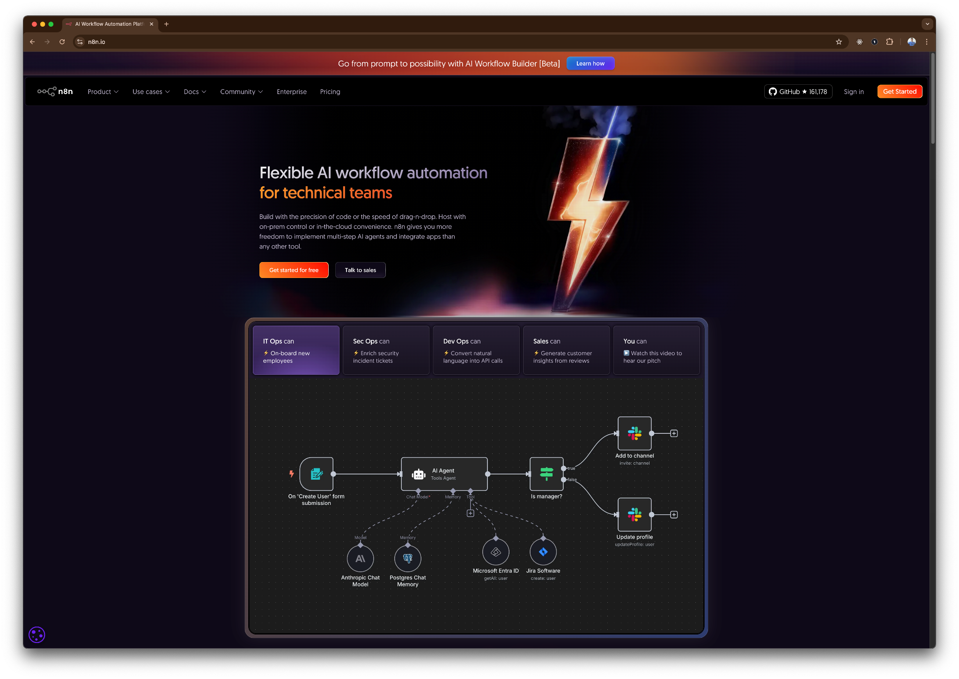
AGENTIC AI BUILDER
Live with n8n cloud in minutes

Slide 4



I’M SO HAPPY TO WELCOME YOU TO
Agentic AI Builder
Prepare to build
This course is hands-on creating
Prepare for impact
For your business, your products, your clients
Prepare for fun
I had a blast making this and you will too!

Slide 5


OBJECTIVES
Who is this FOR?
Product and Business People
AI Engineers
Create high impact Agentic AI products without coding
Apply AI to real-world use cases at an astonishing pace
And everyone in between
By the end of the course you will be able to:
Create AI Agents and Voice Agents that solve business problems
Apply to jobs or respond to engagements to build AI Agents
Automate, Accelerate and Amplify your business & your clients

Slide 6
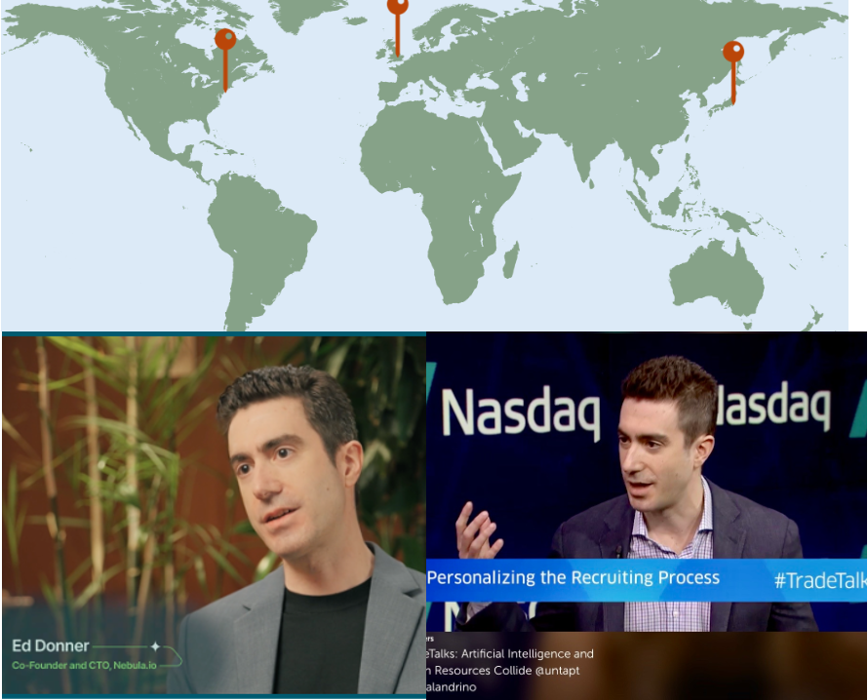
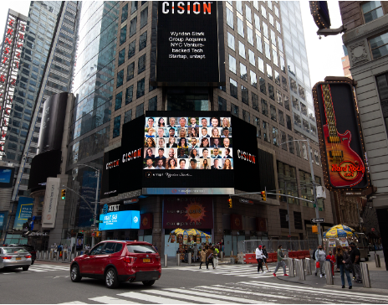


Slide 7
MY OTHER COURSES
How does this fit?
AI Engineer
AI Leader
AI Builder
AI Engineer
MLOps Track
AI Leadership
Agentic AI Builder
Low-Code AI Agents & Voice Agents in n8n
AI Engineer
Agentic Track
AI Engineer
Core Track
All the courses are complementary and can be taken in any order
All levels of background - something for everyone

Slide 8

3 Weeks to Agentic AI Builder
Core skills
Integrations
Projects
Week 3: Amplify with multi-agent systems and MCP
Self-hosted n8n and Local LLMs
Advanced Integrations
MCP
Context Engineering, Sub-Agents
Capstone: Amplify your business
Week 2: Accelerate with Voice Agents and RAG
Voice Agents with ElevenLabs
Integrating ElevenLabs and n8n
RAG and Agentic RAG
Supabase Vectors and Data ingest
Product Expert Voice Agent
Week 1: Automate with workflows in n8n cloud
First n8n AI Agent Live
Foundations: Agentic AI and n8n
Integrations with docs and email
Data and integrations
Daily Portfolio Rebalancer

Slide 9


You probably know this well but
Just so we’re on the same page:
LLM
API
An AI program that generates text to answer questions or decide on actions to take
It’s a pattern matcher that uses statistics to predict likely responses, from analyzing vast amounts of data
It is astonishing that we get this apparent ‘intelligence’ as a byproduct of scale
GPT is an LLM; ChatGPT is an end-user product that uses GPT
A streamlined way to integrate applications and services using common standards
While the term “API” can be used in many contexts, most often it involves connecting applications over the internet
Typically APIs connect using HTTP, the way you fetch a webpage, and data is described using JSON
It’s common for an app to identify itself using an API key

Slide 10
And now:
What is an AI Agent?
Sam Altman
“AI systems that can do work for you independently”
Early 2025 consensus
(Anthropic, Hugging Face, ..)
AI systems where an LLM controls the workflow
Late 2025
An Agent runs Tools in a Loop to achieve a goal

Slide 11



And..
What is n8n?
Workflow Automation Startup founded in Berlin in 2019
Now a many-times-over unicorn with estimated users in millions
Differentiated by simplicity of AI and integrations
Easy for technical and non-technical people to deliver impact in minutes
Use it on the n8n cloud or host it yourself
n8n has a “fair code” license which is important to understand:
You can use n8n for free. You can change the code.
You can deliver value for your company.
You can build client projects that use n8n.
…But you can’t sell n8n itself or build a competing platform with it.

Slide 12

API CHARGES
Costs, API costs and integrations
You are in control! No need to spend anything.
n8n cloud costs $24/month (today) but has a generous free trial; in week 3 we self-host
All integrations are optional and most have free tiers
OpenAI has a minimum $5 balance
We will use OpenRouter as a free alternative and you can use any model
You don’t need to stick to my integrations - experiment!

Slide 13
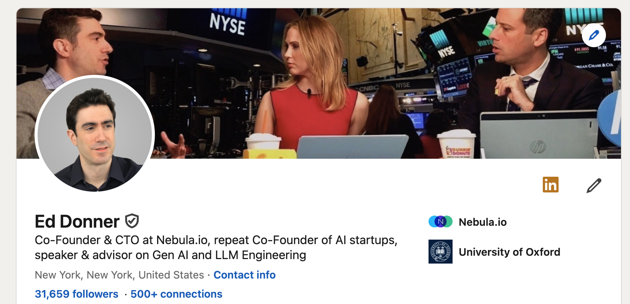
GET IN TOUCH
I am HERE TO HELP
Udemy Q&A
ed@edwarddonner.com
https://www.linkedin.com/in/eddonner/
Connect with me!
Ask questions
Post your projects on LinkedIn, tag me and I’ll weigh in

Slide 14
3 Weeks to Agentic AI Builder
Core skills
Integrations
Projects
Week 3: Amplify with multi-agent systems and MCP
Self-hosted n8n and Local LLMs
Advanced Integrations
MCP
Context Engineering, Sub-Agents
Capstone: Amplify your business
Week 2: Accelerate with Voice Agents and RAG
Voice Agents with ElevenLabs
Integrating ElevenLabs and n8n
RAG and Agentic RAG
Supabase Vectors and Data ingest
Product Expert Voice Agent
Week 1: Automate with workflows in n8n cloud
First n8n AI Agent Live
Foundations: Agentic AI and n8n
Integrations with docs and email
Data and integrations
Daily Portfolio Rebalancer

Slide 15

Agentic AI Builder: Low-Code AI Agents & Voice Agents in n8n
7%
Complete

